Slide 1
TUKL Internship Final Progress & Project Report
By: Syed Muhammad Akbar
Supervisor: Abdul Wahab

Slide 2
Plan
First Two Weeks:
Complete Pre-requisite courses and literature review
Projects:
Literature Review of the Problems
Reproducing the results
Finding room for improvement
Planning the novelty
Implementation and testing

Slide 3
Week 01 - EID
Got in touch with the supervisor Abdul Wahab and group partner Anas Tahir
Reviewed papers:
RNN-based Prediction of TCP Transmission States from Passive Measurements
TCP-Drinc Smart Congestion Control Based on Deep Reinforcement Learning
Short-Term Residential Load Forecasting Based on LSTM Recurrent Neural Network
Decided project: Using LSTM to predict Short-Term Residential Load Forecasting
First six weeks of Machine Learning course followed by deep learning specialization
Early Implementation of the project
Specialization of Tensorflow in Practice

Slide 4
EID onwards…
Data Labeling workshops arranged by the supervisor
Data Labeling tasks
IAPR’s Summer School on Document Analysis
Planning the novelty
Implementation and testing
Going through the problem statement of the next project RNN-based Prediction of TCP Transmission States from Passive Measurements
Advance Machine Learning Specialization started

Slide 5
LOAD FORECASTING
ercot (Texas) dataset as it provide the flexibility of playing with different ideas
The data set has 87648 timesteps with five features which comprised of Dry Bulb, Dew Point, Wet Bulb, Humidity, Electric Price and date, min and year as features to specify the moment time.

Slide 6
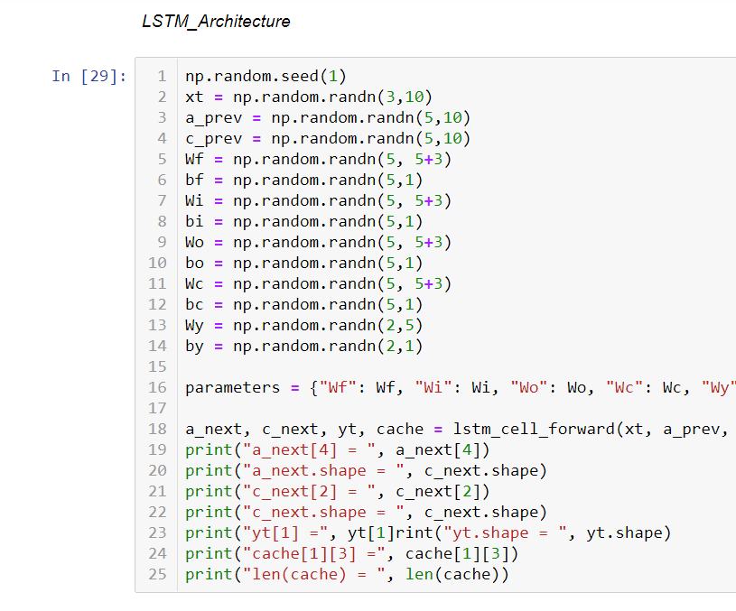
Initial tries

Slide 7
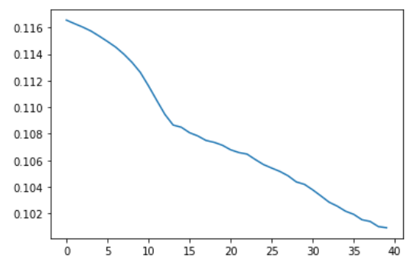
Short-Term Residential Load Forecasting Based on LSTM Recurrent Neural Network
Ultimately switched to the Keras in Tensorflow
All the features and previous loads were converted into a matrix
They were normalized
Then, they were fed into the LSTMs
Mean Squared Error was used as the loss function
Promising results with loss of 0.1009

Slide 8
Learning and improving
Felt that it was difficult to code the concepts that I learnt
Started specialization “Tensorflow in Practice” for improving implementation skills
Organized code snippets on register
Gone through several architecture which target this specific task

Slide 9
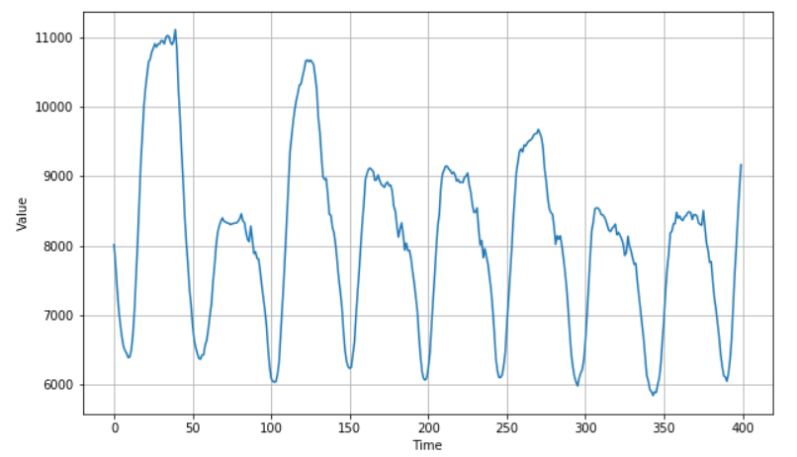
Simple Data Analysis
day
night

Slide 10
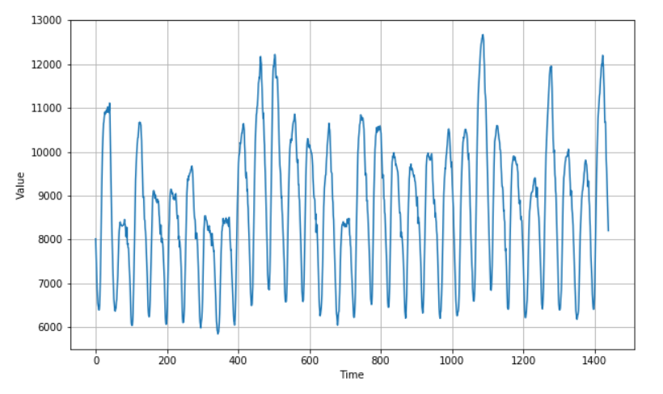
Simple Data AnalysiS

Slide 11
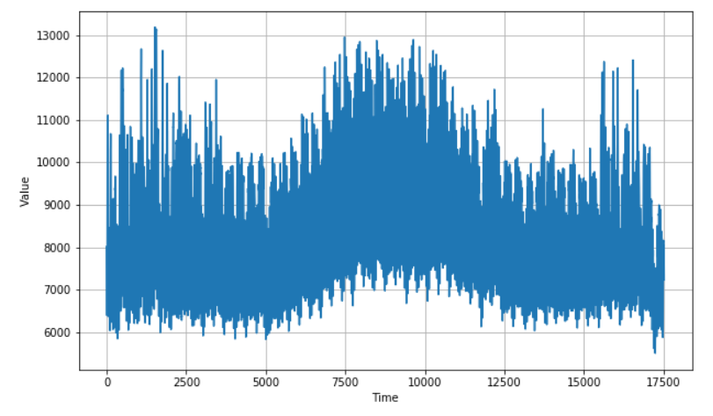
Simple Data Analysis
SUMMERS!

Slide 12
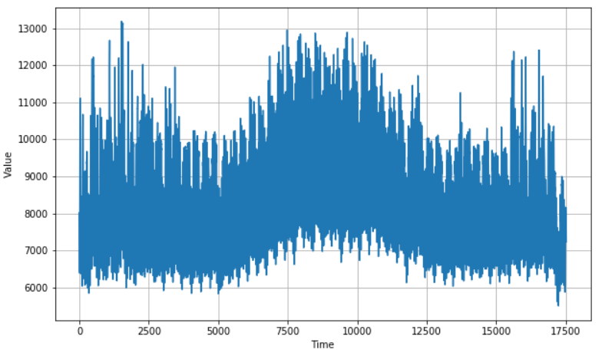
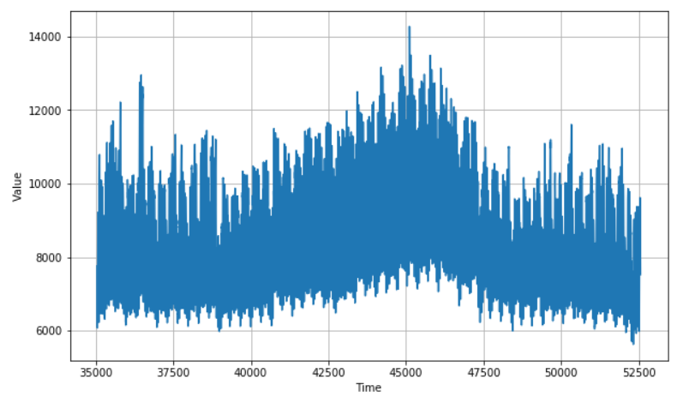
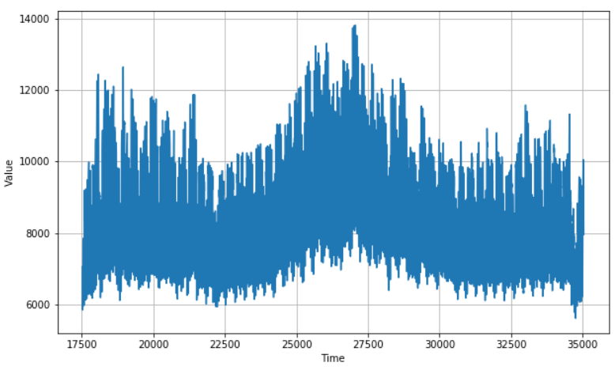
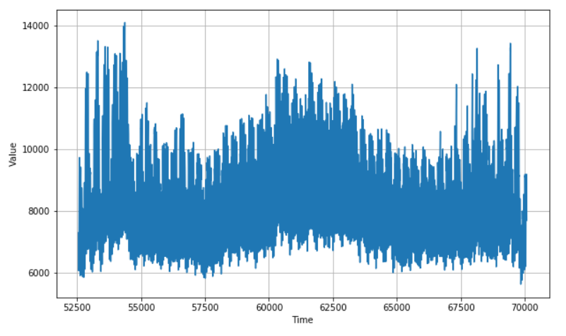
Simple Data Analysis (No annual up-trend)

Slide 13
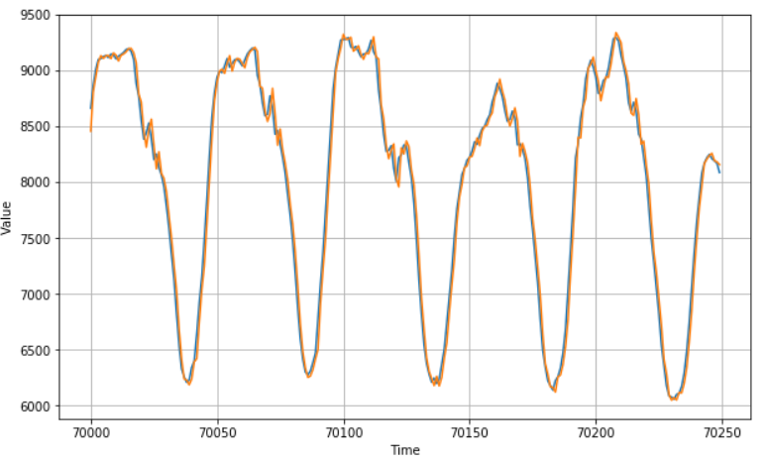
NN Architecture
Architecture:
JUST ONE DENSE UNIT
MAPE (validation): 1.5297
loss: 1.4961
Optimizer: Adam

Slide 14
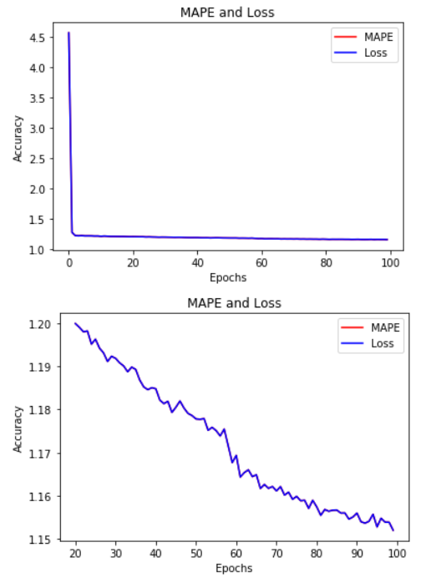
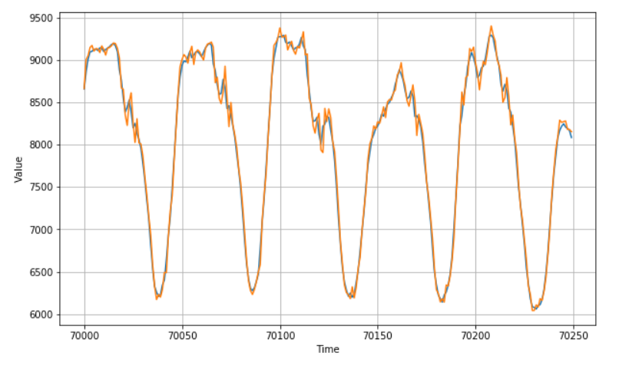
DNN Architecture
Architecture:
Input Layer: 2 time-step
Hidden layer # 1: 20 Dense Units
Hidden layer # 2: 20 Dense Units
Output layer: 1 Dense Unit
MAPE (validation): 1.0593085

Slide 15
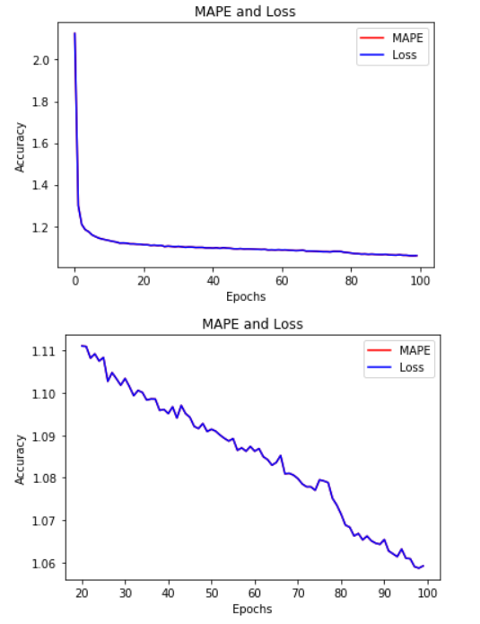
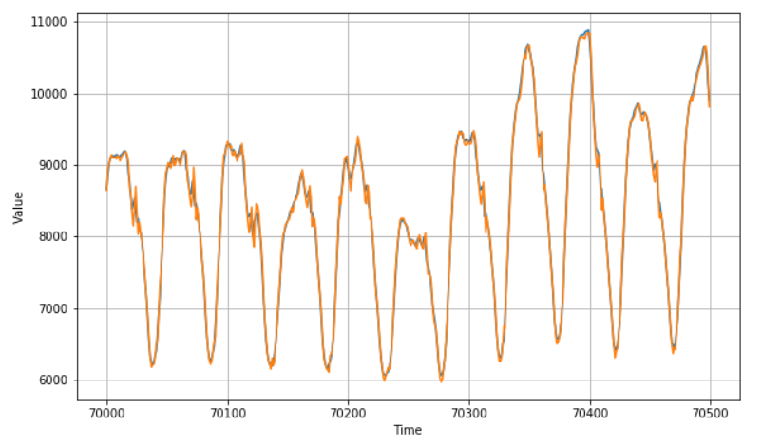
DNN + CNN (1D) Architecture
Architecture:
CNN 1D
DNNs (two layers)
MAPE: 1.0635368

Slide 16
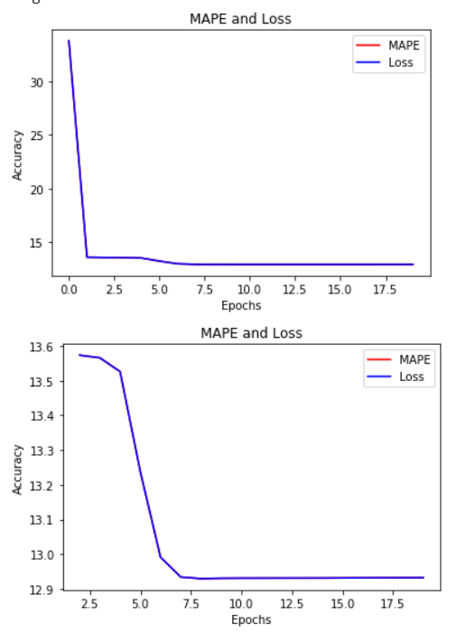
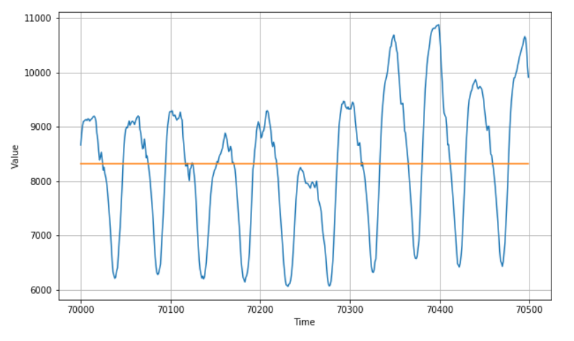
DNN + cnn+ LSTM = Disaster
Architecture:
(1) CNN 1D
(2) LSTMs layers
(2) Dense layers
(1) Output Dense layer

Slide 17
Overall experience
Fun and exciting
Feel fully equipped to learning new methods and face new challenges
Developed the thrust of learning more
Side-Study:
Q-learning (Completed)
Environment development (In Progress) {gym}
Data Generation (TCP protocol congestion simulation)
Deep Reinforcement Learning (Agenda)
Unconventional

